Slide 1
CARES and Frailty in Primary Careg Coordinating Complex Care Initiative “Frailty Management in Primary Care, the CARES Model” February 16, 2021
Dr Grace H Park
Regional Medical Director Home Health

Slide 2
Canadian Life Expectancy

Slide 3
Addressing Frailty in Primary Care
‘At risk/ pre-frail’ seniors living in communities
Increased susceptibility to disability and poor health outcomes
Pre-frail and early-frail seniors are becoming frail unnecessarily
Primary care team is best positioned to assess for emerging frailty and manage it in community
Notes:
We know our population is aging and we see it in our practices. We are living longer but spending the last 8-10 years with frailty
Provide some further tools to address healthy aging in your patients
As population ages, we notice patients, living at risk, becoming frail over time
As PCP we follow patients over decades and are best positioned to intervene early

Slide 4
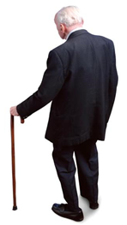
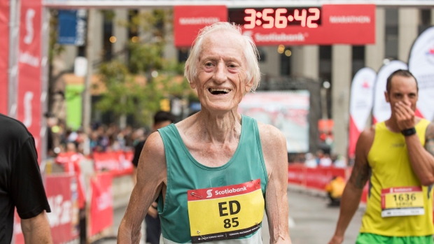
Frailty – the noun: unmeasured heterogeneity
Vaupel J, Manton K, Stollard E. The impact of heterogeneity in individual frailty on the dynamics of mortality. Demography 1979; 16:439-54
Frail – the adjective: “Is this person frail and how can we tell?” Can J Cardiol 2016;32:1046-50.
Measuring frailty must reduce the unmeasured heterogeneity of age.
Notes:
Variability in aging, mortality rate increases as people get older
We all know about the ‘super seniors’
The Blue Zone in parts of the world where long life is the norm

Slide 5
Early Identification of Frailty at Primary Care
Identify frailty early – GP/NP assessments
4.5% increase in deficits per year- doubles in 15 years
75 – 90 years old – last doubling time (2021 – baby boomers hit 75 y.o.)
Opportunity for intervention before frailty too advanced
60 – 75 years old – doubling time - to intervene
Reverse components of frailty with evidence based assessments – identify health deficits; comprehensive assessment
Develop a care plan addressing health deficits and connecting with health protective interventions
Notes:
with the Clinical Frailty Score described earlier, one may not LOOK frail until you are more advanced
So need to be proactive – identify the frailty, measure it and intervene before it becomes advanced

Slide 6
Frailty Index
FI is the Ratio of Number of Deficits present / Total Possible Deficits looked at.
Expressed as a 0 (lowest) to 1 (highest level of frailty) score.
No universally agreed upon scoring.
Generally: 0 – 0.08 = Non-frail
0.09 – 0.24 = Pre-frail
0.25 or higher = Frail
Those with FI of > 0.5 have near 100% mortality at 20 months (useful for end of life discussions).
FI >0.7 usually not compatible with living.
Notes:
Song X, Mitnitski A, Rockwood K. Prevalence and 10-year outcomes of frailty in older adults in relation to deficit accumulation. Journal of the American Geriatrics Society 2010; 58(4): 681-7.
0-0.08 = Non frail
0.25 or higher = frail
Can be a reflection of biological aging rather than chronological aging

Slide 7
Proactively Delaying Frailty in At-risk Seniors
CARES:
Community Actions & Resources Empowering Seniors
Is a targeted initiative which partners primary care physicians with at-risk seniors and Community Based Seniors Services
Uses the Comprehensive Geriatric Assessment (CGA) and the Frailty Index (FI) as a measure of the senior’s progress toward or away from frailty
Embeds CGA-FI into the physician’s EMR for point of service calculation of the FI
Notes:
CARES partnerships include:
Divisions of Family Practice
University of Dalhousie
Nova Scotia Health Authority
University of Victoria’s Institute on Aging and Lifelong Health
Canadian Foundation for Health Care Improvement
Canadian Frailty Network

Slide 8
CARES intervention
Comprehensive geriatric assessment (eCGA, eFI)
Done in EMR – self populates with patient information in
Yearly with complex care planning
CIHR research opportunity with LPN support (0,6mo, 12, 18)
Intrahealth Profile
Oscar (coming in April 2021)
Telus Med Access
Telus Wolf
Stand alone
Web Based (coming end of 2021)
Notes:
Evidence based CGA open in patients chart through our work with EMR Vendors. It has been time and resource intensive so we wish to share with other community physicians.
EMR agnostic Stand alone version also available

Slide 9
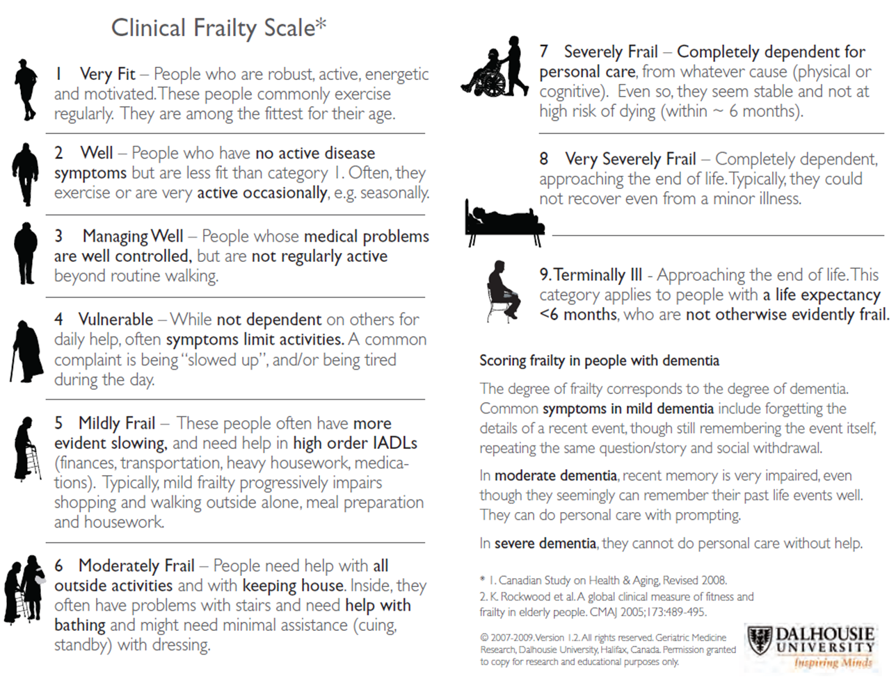
Frailty Guide
Notes:
This is what we use as the rapid screen for CARES intervention – CFS 4-6
It is Frailty – the dark side of aging – the opposite of Healthy Aging
It seems inevitable but research shows us that it is not
We now identify Frailty and have come up with definitions that we can all agree on; This is a Frailty Scale developed by Dr Ken Rockwood – used widely
CFS 1 – 9
We can grade frailty from the very fit – level 1 and onto higher levels of frailty and dependence

Slide 10
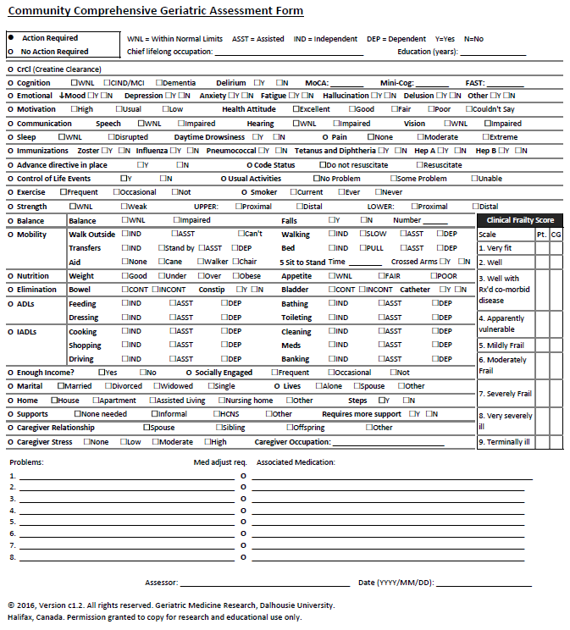
Frailty Assessment Tools
RN, LPN Administered Tools:
Montreal Cognitive Assessment (MoCA) - Nasreddine, Z. (2003) or
Mini-Cog – Borson (2016)
Five Times Sit to Stand Test - Guralnik (2000)
Delegated eCGA sections
Physician Administered Tools:
Community Comprehensive Geriatric Assessment (CCGA) -Geriatric Medicine Research, Dalhousie University (2016)
Medical Office Assistant
Faxes coaching referral form to Self-Management BC, social prescribing req
IADL, ADL deficit fields
Notes:
Collaboration with Rockwood
Electronic c-CGA, integrated in GP Office EMR
Team based care with PCNs and PMHJs
Can be done yearly – like the Rourke pediatric assessment record – yearly senior CC record and CCP
Outcome is the opportunity for Care Planning

Slide 11
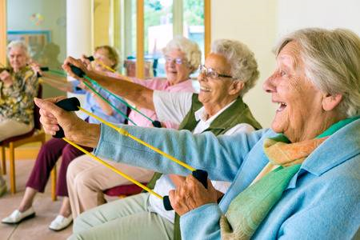
Approach to Care Plan Development
T
Inquire about patient’s primary concerns
Review patient goals of care
Review history
Medication review
Advance care planning
Communicate care plan
Reassess care plan
Care Plan Development
Wellness Plan Development / Health Protective Factors
Care Plan
Healthy diet
Socialization
Exercise
Caregiver support
Social Prescribing / Seniors Community Connectors (SCC)
CBSS resources, through UW
GPs refer directly to SCC
Community peer coach works with SCC Group
Notes:
This is the process that can be used for Complex Care Planning – after the CGA
Health protective Factors and development of the Wellness Plan
Social prescribing for non clinical issues
Care planning can be done yearly for on going seniors care

Slide 12
Social Prescribing
Health Protective Factors:
Healthy diet
Socialization
Exercise
Care Giver support
Seniors’ Community Connectors (SCC)
Aware of CBSS resources; hired through United Way
GPs refer directly to SCC to include; socialization in community activities, exercise venues, community kitchens etc.
Community peer coach works with SCC.
Notes:
Social prescribing – NEW in FH - is a non medical intervention that is helpful for vulnerable and at risk seniors
Partnership with United Way and CBSS
We work with GPs to help identify the need

Slide 13
Health and Social Services Integration – Social Prescribing
CARES in Fraser Health Authority; an example
Integration of Health care ( GPs, GENs, HH CHN, SWs) and social services sector
Project to identify and prevent frailty to promote healthy aging and self management (independence)
Creation of a point of contact for GPs/NPs
Seniors Community Connector
Social Prescription program
Work with local CBSS, hospital and community foundation to develop social capital and social cohesion
Notes:
We identify and measure Frailty as a Proxy for Healthy Aging and living well.
Frailty increases all by itself just by aging – if do nothing increases by 4.5% per year, doubles in 15 years; 30 to 45; 45 to 60 , 60 to 75 and lastly 75 to 90

Slide 14
A Simple Idea
Notes:
Early identification of social vulnerability
Proactive frailty assessment and care planning
Connector is more than a ‘navigator’
Sets motivation, smart goals, reduce barriers

Slide 15
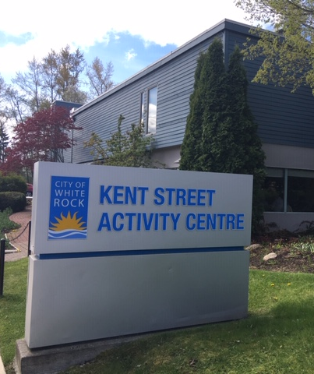
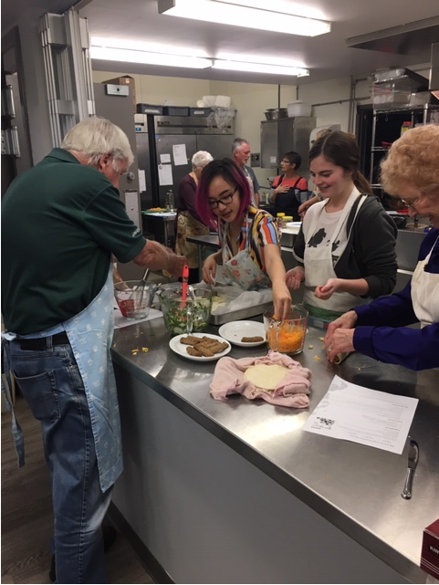
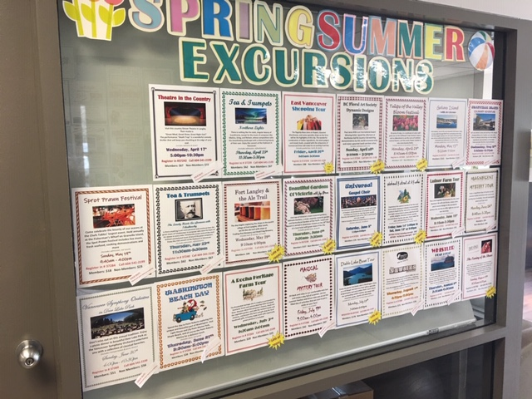
Kent Street Activity Centre
Notes:
Every community has similar activity centres. In my community…. Intergenerational kitchen
Excursions
Games etc.

Slide 16
The CARES Collaboration
Information for GPs
Billing information
Education on frailty video by Dr. Ken Rockwood
CIHR Research
BC Alignment with Primary Care Network and TBC ,BC Guidelines
United Way and CBSS – social prescribing
PSP office support for QI senior care
Dr. Ken Rockwood
Notes:
Billing information regarding Care planning with local home health team; yearly CCP fee; councelling sessions etc re Social Prescribing
Referral to SP on Pathways with local NGOs and the referral forms
Ongoing support of SP through connection of SCC with Division
PSP QI project – leads to CME credits and sessional funds for your time to set up CARES for ongoing care of your seniors over the years

Slide 17
Summary
CARES model brings education to primary care providers to identify and assess frailty, share toolkit
eFI generated by eCGA leads to a multidisciplinary care plan. For EMRs and Stand Alone eCGA
Wellness plan and referral to community coach leads to social prescribing through one intake process by Community seniors connector.
Measuring eFI pre and post wellness intervention and ongoing care planning by primary care provider.
Evaluation ongoing to measure health outcomes, health utilization and QoL measures.
Notes:
Monitoring FI over the years
Motivational interviews, goal setting with seniors to improve health protective factors
UW evaluation for social prescribing, health outcomes and QoL measures

Slide 18
Contact information
Grace.park@fraserhealth.ca
Physician lead for CARES at FH
BobbiS@uwlm.ca
Social prescribing in BC; United Way
FH and CARES
helpful background info on CARES
Acutefrailtynetwork.org.uk
Information on clinical frailty scale use

Slide 19
CGA Demo

