Slide 1
BLCS 1 Overview Slides
This is a compilation of slides that can be adapted to the needs of a particular group

Slide 2
What exactly is Polypharmacy?
Notes:
Involve all members of the “Circle of Care” from the get-go
Raises awareness, facilitates buy-in, prevents moral distress
Respect people’s time and contributions
Create review schedule in advance so team can be prepared with the correct information

Slide 3
Various Descriptive Definitions Around the World
Multiple Medications
One Inappropriate Medication
More than 5 medications
More than 5 inappropriate medications
More than 10 appropriate medications
Notes:
Involve all members of the “Circle of Care” from the get-go
Raises awareness, facilitates buy-in, prevents moral distress
Respect people’s time and contributions
Create review schedule in advance so team can be prepared with the correct information

Slide 4
What is Polypharmacy?
Our working definition
When the theoretical benefits of multiple medications are outweighed by the negative effect of the sheer number of medications, regardless of class of medication or “appropriateness” thereof.
Notes:
Involve all members of the “Circle of Care” from the get-go
Raises awareness, facilitates buy-in, prevents moral distress
Respect people’s time and contributions
Create review schedule in advance so team can be prepared with the correct information

Slide 5
Polypharmacy is a stand-alone risk factor for morbidity and mortality
Even when we control for other comorbidities and specific drug effects.

Slide 6
What are the risks of Polypharmacy?.
Notes:
Involve all members of the “Circle of Care” from the get-go
Raises awareness, facilitates buy-in, prevents moral distress
Respect people’s time and contributions
Create review schedule in advance so team can be prepared with the correct information

Slide 7
Decreased:
Cognitive function, ADL’s, Quality of Life
Increased:
ADE’s, Falls, Transfers to Acute Care
Which leads to:
Hospitalization Associated Disability
Notes:
Involve all members of the “Circle of Care” from the get-go
Raises awareness, facilitates buy-in, prevents moral distress
Respect people’s time and contributions
Create review schedule in advance so team can be prepared with the correct information

Slide 8
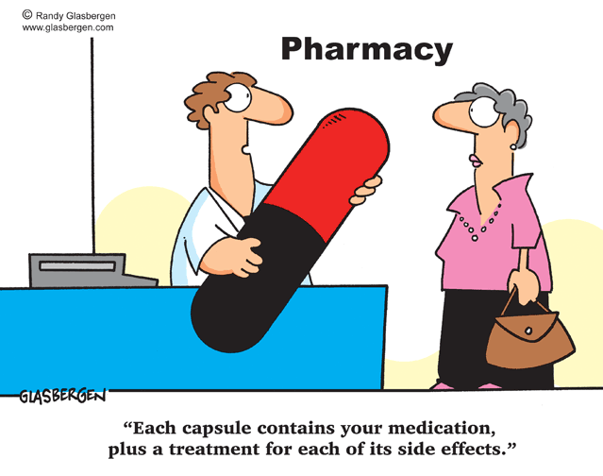
Notes:
The drug cascade

Slide 9
Adverse Drug Reactions
The most consistent risk factor for adverse drug reactions is:
number of drugs being taken
Risk rises exponentially as the number of drugs increases.

Slide 11
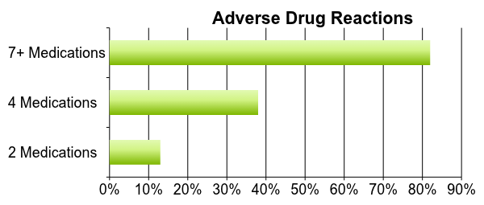
Atkin PA, Veitch PC, Veitch EM, Ogle SJ. The epidemiology of serious adverse drug reactions among the elderly. Drugs Aging 1999;14:141-152

Slide 12
Accumulation of minor side effects = people could feel and function better!
Change in metabolism with aging
Drug-drug, drug disease, drug-nutrition interactions
Cycle of side effects, more tests, drug cascade-Let’s interrupt this negative cycle

Slide 13
So, if common side effects of most medications include….
Fatigue, weakness, muscle aches
Anorexia, nausea, bloating, cramps, constipation, diarrhea
Dizziness, postural instability
Headaches

Slide 14
Accumulation of minor side effects leads to feeling…
CRAPPY
Notes:
crappy

Slide 15
Hospitalization-Associated Disability
Hospitalization is a sentinel event that often precipitates disability. This results in the subsequent inability to live independently and complete basic activities of daily living (ADLs). This hospitalization-associated disability occurs in approximately one-third of patients older than 70 years of age and may be triggered even when the illness that necessitated the hospitalization is successfully treated.

Slide 16
What Is The Scope of the Problem?
Notes:
Involve all members of the “Circle of Care” from the get-go
Raises awareness, facilitates buy-in, prevents moral distress
Respect people’s time and contributions
Create review schedule in advance so team can be prepared with the correct information

Slide 17
Seniors
In Canada (in 2012):
65.9% of all seniors (>65) on 5 or more prescription drugs
27.2% are on 10+ prescription drugs
“Residential” LTC care seniors in BC:
Average number of medications per patient: 9 (0-55!)
About 35% of LTC patients are on 10+ medications
CIHI Report: Drug Use Among Seniors on Public Drug Programs in Canada, 2012, published May 2014:
https://secure.cihi.ca/free_products/Drug_Use_in_Seniors_on_Public_Drug_Programs_2012_EN_web.pdf
Notes:
So, how bad is this problem? All seniors (65+) in Canada, whether healthy and independent or not, are getting more than their share of prescription medications: 2/3 (65.9%) are on 5 or more, and more than ¼ are on 10 or more meds!
In nursing homes, what we call residential care in BC, the numbers are even higher: about 35% are on 10 or more medications.

Slide 18
“Every year, one in three adults 65 or older has one or more adverse (harmful) reactions to a medication or medications.”
American Geriatric Society, Beers Criteria 2012
www.americangeriatrics.org.

Slide 19
Polypharmacy: Medications may be inappropriate if:
Goes against patient’s goals of care
Lack of clear indication
Adverse effects, drug interaction, allergy
Incorrect duration
Incorrect dose
Notes:
This is a broader view that incorporates the patient’s/resident’s goals of care in relation to their health status and frailty…

Slide 20
What Causes Polypharmacy?
Patient-Centered:
Change in how the elderly metabolize/tolerate medications
Multiple comorbidities/symptoms
Clinical Practice Guidelines
Clinical uncertainty
Uncertain treatment goals
The pressure to “Do something”
Drug companies emphasize benefits & downplay the risks
System-Related:
Lack of history
Lack of communication
Multiple prescribers-SPECIALIST consultation (10 years ago?)
Acute Care admission
Physician/patient/family reluctance: “Don’t change anything!”
Treating side effects of another pill
Free medications

Slide 21
Common Chronic Conditions and Polypharmacy
Prevention and/or Symptom Management
Cardiovascular risk:
Hypertension: 2 meds (of Calcium channel blocker, ACE inhibitor, diuretic)
Hypercholesterolemia: 1 med (Statin)
Diabetes: 2 meds as disease progresses (Metformin + Sulfonylurea-Glicazide
Atrial fibrillation: 1 med (Warfarin, NOACS)
Coronary artery disease: 2 meds (Aspirin, Beta-blocker- if angina)
Heart failure: 3 meds (Diuretic, ACE-I, Beta-blocker)
Chronic obstructive pulmonary disease: 2 drugs (Inhalers- Sympathetic/cholinergic systems)
Bone metabolism (mostly women): 2 meds (Ca, Vit D), Bisphosphonate if osteoporosis and high risk of fracture
Osteoarthritis: If pain (analgesic- Acetaminophen, NSAID, opioid)
Cancer: Depends on type re: long term Tx
GI: Dyspepsia (Antacid), Gastroesophageal reflux disease (GERD)- H2B, PPI
Notes:
This slides show how medications, prescribed according to clinical practice guidelines which are developed based upon evidence for younger populations, can accumulate.

Slide 22
Frail Elderly Related Conditions and Polypharmacy
Urinary outflow issues: 1 med (anticholinergic)
Constipation: 1-2 meds
Dementia: 1 drug (Donepezil covered in BC)
Multi-morbidity: Meds as per previous slide
Frailty: Vitamins and minerals
Non-specific symptoms**
End of life/palliative care: Add meds for Dyspnea, GI, Pain
Notes:
This slide shows how elderly, particular frail elderly, related conditions can generate additional medications over and above the usual chronic conditions.

Slide 23
So What Can We Do?- Evidence of Benefit For Medication Reviews In Residential care
Case-control study over 1 year, mod-severe demented Israeli facility residents on ~ 7 drugs* (Garfinkel)
2.8 drugs/patient stopped (all types of medications)
Only 18% drugs / 10% patients had the stopped meds restarted over a year
Decr mortality (21 vs 45%)→NNT 4.1
Decr acute care transf (12 vs 30%)→NNT 5.5
This is when average stay is ~ 1 yr!
* IMAJ 2009;9:430-434
Notes:
There are 2 Garfinkel studies- this is on the more complex patients that were in a kind of TCU in acute; the other study is on community elderly so less applicable
CR

Slide 24
Evidence- Community Elderly (Garfinkel)
Algorithmic approach-we adapted
70 patients, mean age 83, 3+ co-morbidities, over 19 months, mean 8 drugs
In 64 patients, recommended D/C 311 drugs (4.4 per patient overall), wide range of drugs
2% re-start for original indication (furosemide, SSRI…)
No significant adverse events or deaths were attributable to discontinuation, including hospitalization
88% of patients re- ported global improvement in health
Arch Intern Med. 2010;170(18):1648-1654
Notes:
This is an extra slide as it was the study done in community elderly but shows great results from the same med review approach…

Slide 25
So What Strategies Could Make The Path To Deprescribing More Acceptable?
Understand the individual health status, including chronic diseases and frailty, and the related Goals of Care… this sets the context for addressing medications
Explaining as:
Dosage reduction, tapering with monitoring and review- this is a valid clinical strategy as well
Stating the objective as ‘Pause and Monitor’ rather than ‘deprescribing’ or ‘stopping medications’- this is a valid clinical strategy as well

